Slide 1
DBMS Module 1
ER Modeling

Slide 2
Relational model basics
Data is viewed as existing in two dimensional tables known as relations
A relation (table) consists of unique attributes (columns) and tuples (rows)
Tuples are unique
Sometimes the value to be inserted into a particular cell may be unknown, or it may have no value. This is represented by a NULL
Null is not the same as zero, blank or an empty string
Relational Database: Any database whose logical organization is based on relational data model.
RDBMS: A DBMS that manages the relational database.
Notes:
Though logically data is viewed as existing in the form of two dimensional tables, actually, the data is stored under the file system only.
The RDBMS provides an abstraction on top of the file system and gives an illusion that data resides in the form of tables.

Slide 3
What is the technical term for row in DBMS?
Tuple
Attribute
Relation
Null
RollNo | Name | CPI
1 | Amit | 7.2
2 | Ajay | 8.1
3 | Manoj | 8.3
4 | Vijay | 7.9
: | : | :
: | : | :

Slide 4
What is the technical term for column in DBMS?
Tuple
Attribute
Relation
Null
RollNo | Name | CPI
1 | Amit | 7.2
2 | Ajay | 8.1
3 | Manoj | 8.3
4 | Vijay | 7.9
: | : | :
: | : | :

Slide 5
What is the technical term for table in DBMS?
Tuple
Attribute
Relation
Null
RollNo | Name | CPI
1 | Amit | 7.2
2 | Ajay | 8.1
3 | Manoj | 8.3
4 | Vijay | 7.9
: | : | :
: | : | :

Slide 6
Sometime data is unknown or missing it is represented by ?
Tuple
Attribute
Relation
Null
RollNo | Name | CPI
1 | Amit | 7.2
2 | Ajay | ?
3 | Manoj | ?
4 | Vijay | 7.9
: | : | :
: | : | :

Slide 7
Keys in Relational Model
Candidate key
A Candidate key is a set of one or more attributes(minimal) that can uniquely identify a row in a given table.
Primary Key
During the creation of the table, the Database Designer chooses one of the Candidate Key from amongst the several available, to uniquely identify row in the given table.
ClassRollNo | UnivRollNo | aadhaarNo | Name | 31-01-2022
1 | 201500001 | 626987564329 | Amit | P
2 | 201500056 | 876945214872 | Arun | A
3 | 201500132 | 762419735736 | Binod | P
Notes:
Candidate Key
An attribute, or group of attributes, that is sufficient to distinguish every tuple in the relation from every other one.
A candidate key is all those set of attributes which can uniquely identify a row. However, any subset of these set of attributes would not identify a row uniquely
For example, in a shipment table, “S#, P#” is a candidate key. But, S# alone or P# alone would not uniquely identify a row of the shipment table.
Primary key
The candidate key that is chosen to perform the identification task is called the primary key.
Every tuple must have, by definition, a unique value for its primary key. A primary key which is a combination of more than one attribute is called a composite primary key .
Superkey
Any superset of a candidate Key is a super key.
OR
An attribute, or group of attributes, that is sufficient to distinguish every tuple in the relation from every other one.
For example, in a shipment table, “SupplierNo, PartNo” is a super key. if, SupplierNo alone or PartNo alone would uniquely identify a row of the shipment table.

Slide 8
Keys in Relational Model
Candidate key
Primary Key
Alternate Key
The candidate key that is chosen to perform the identification task is called the primary key and the remaining candidate keys are known as alternate keys.
No of Alternate Keys = No of Candidate Keys - 1
Super Key
Any superset of a candidate Key is a super key.
ClassRollNo | UnivRollNo | aadhaarNo | Name | 31-01-2022
1 | 201500001 | 626987564329 | Amit | P
2 | 201500056 | 876945214872 | Arun | A
3 | 201500132 | 762419735736 | Binod | P
Notes:
Candidate Key
An attribute, or group of attributes, that is sufficient to distinguish every tuple in the relation from every other one.
A candidate key is all those set of attributes which can uniquely identify a row. However, any subset of these set of attributes would not identify a row uniquely
For example, in a shipment table, “S#, P#” is a candidate key. But, S# alone or P# alone would not uniquely identify a row of the shipment table.
Primary key
The candidate key that is chosen to perform the identification task is called the primary key.
Every tuple must have, by definition, a unique value for its primary key. A primary key which is a combination of more than one attribute is called a composite primary key .
Superkey
Any superset of a candidate Key is a super key.
OR
An attribute, or group of attributes, that is sufficient to distinguish every tuple in the relation from every other one.
For example, in a shipment table, “SupplierNo, PartNo” is a super key. if, SupplierNo alone or PartNo alone would uniquely identify a row of the shipment table.

Slide 9
Candidate Key
An attribute, or group of attributes, that is sufficient to distinguish every tuple in the relation from every other one.
A candidate key is all those set of attributes which can uniquely identify a row. However, any subset of these set of attributes would not identify a row uniquely
For example, in a shipment table, “S#, P#” is a candidate key. But, S# alone or P# alone would not uniquely identify a row of the shipment table.
Primary key
The candidate key that is chosen to perform the identification task is called the primary key.
Every tuple must have, by definition, a unique value for its primary key. A primary key which is a combination of more than one attribute is called a composite primary key .
Superkey
Any superset of a candidate Key is a super key.
OR
An attribute, or group of attributes, that is sufficient to distinguish every tuple in the relation from every other one.
For example, in a shipment table, “SupplierNo, PartNo” is a super key. if, SupplierNo alone or PartNo alone would uniquely identify a row of the shipment table.

Slide 10
Which of the following are candidate keys?
LicensePlateNumber | ChasisNo | ModelName | ManufacturerName | No_of_seats
LicensePlateNumber
ChasisNo
ModelName
ManufacturerName
No_of_seats

Slide 11
Which of the following you will choose as Primary key?
LicensePlateNumber | ChasisNo | ModelName | ManufacturerName | No_of_seats
LicensePlateNumber
ChasisNo
ModelName
ManufacturerName
No_of_seats

Slide 12
Which of the following will be alternate key if LicensePlateNumber is your Primary key?
LicensePlateNumber | ChasisNo | ModelName | ManufacturerName | No_of_seats
LicensePlateNumber
ChasisNo
ModelName
ManufacturerName
No_of_seats

Slide 13
Which of the following are super key?
LicensePlateNumber | ChasisNo | ModelName | ManufacturerName | No_of_seats
LicensePlateNumber
ChasisNo
ChasisNo, ModelName
ManufacturerName
No_of_seats, LicensePlateNumber
F. ManufacturerName, No_of_seats

Slide 14
Key and Non-key Attributes in Relational Model
Key Attributes
The attributes that participate in the Candidate key are Key Attributes
Non-Key Attributes
The attributes other than the Candidate Key attributes in a table/relation are called Non-Key attributes.
OR
The attributes which do not participate in the Candidate key.

Slide 15
Example
Given a relation
Trainee(Empno, FirstName, LastName, Email, PhoneNo)
Candidate key:
{Empno},{Email},{PhoneNo}
Primary key:
{Empno}
Alternate Key:
{Email},{PhoneNo}
Super Key:
{Empno},{Empno,PhoneNo},{Email,FirstName}, etc…
Each candidate key is a super key. But vice versa is not true

Slide 16
Exercise on Key attributes
Given a relation R1(X,Y,Z,L) and the following attribute(s) can uniquely identify the records of relation R1.
1)X
2)X,L
3)Z,L Identify the following in relation R1?
Candidate Key(s) :
Primary Key:
Alternate Key
Key attribute(s)
Non-key attribute(s)
{X}, {Z,L}
ANYONE OF {X}, {Z,L}
{Z,L} if {X} is primary key
X, Z, L
Y

Slide 17
Which of the following are key attributes?
LicensePlateNumber | ChasisNo | ModelName | ManufacturerName | No_of_seats
LicensePlateNumber
ChasisNo
ModelName
ManufacturerName
No_of_seats

Slide 18
Which of the following are non-key attributes?
LicensePlateNumber | ChasisNo | ModelName | ManufacturerName | No_of_seats
LicensePlateNumber
ChasisNo
ModelName
ManufacturerName
No_of_seats

Slide 19
Foreign Key
Foreign key
A Foreign Key is a set of attribute (s) whose values are required to match values of a column in the same or another table.
DEPT EMP
(Parent /Master/Referenced Table) (Child /Referencing Table)
Point to remember
Foreign key values do not (usually) have to be unique.
Foreign keys can also be null .
DeptNo | DName
D1 | IVS
D2 | ENR
EmpNo | EName | EDeptNo
1001 | Elsa | D1
1002 | John | D2
1003 | Maria | Null
1004 | Maida | D1
Notes:
Foreign key
Usually a foreign key is a “copy” of a primary key that has been exported from one relation into another to represent the existence of a relationship between them.
Foreign key values do not (usually) have to be unique.
Foreign keys can also be null .

Slide 20
Foreign Key
Foreign key
Points to remember
A Foreign Key is a set of attributes of a table, whose values are required to match values of some Candidate Key in the same or another table
The constraint that values of a given Foreign Key must match the values of the corresponding Candidate Key is known as Referential constraint
A table which has a Foreign Key referring to its own Candidate Key is known as Self-Referencing table

Slide 21
A foreign key is:
A. a column containing the primary key of another table.
B. used to define data types.
C. used to define null status.
D. all of the above are above correct.

Slide 22
Can following scenario is possible??
Adding a row with D3 ??
Yes
No
DEPT EMP
(Parent /Master/Referenced Table) (Child /Referencing Table)
DeptNo | DName
D1 | IVS
D2 | ENR
EmpNo | EName | EDeptNo
1001 | Elsa | D1
1002 | John | D2
1003 | Maria | Null
1004 | Maida | D1
1005 | Imran | D3
Notes:
Foreign key
Usually a foreign key is a “copy” of a primary key that has been exported from one relation into another to represent the existence of a relationship between them.
Foreign key values do not (usually) have to be unique.
Foreign keys can also be null .

Slide 23
Can following scenario is possible??
Adding a row with NULL ??
Yes
No
DEPT EMP
(Parent /Master/Referenced Table) (Child /Referencing Table)
DeptNo | DName
D1 | IVS
D2 | ENR
EmpNo | EName | EDeptNo
1001 | Elsa | D1
1002 | John | D2
1003 | Maria | Null
1004 | Maida | D1
1005 | Imran | Null
Notes:
Foreign key
Usually a foreign key is a “copy” of a primary key that has been exported from one relation into another to represent the existence of a relationship between them.
Foreign key values do not (usually) have to be unique.
Foreign keys can also be null .

Slide 24
Consider attributes ID, CITY and NAME. Which one of this can be considered as a super key? a) NAME b) ID c) CITY d) CITY, ID
The subset of a super key is a candidate key under what condition? a) No proper subset is a super key b) All subsets are super keys c) Subset is a super key d) Each subset is a super key

Slide 25
Consider attributes ID, CITY and NAME. Which one of this can be considered as a super key? a) NAME b) ID c) CITY d) CITY, ID
The subset of a super key is a candidate key under what condition? a) No proper subset is a super key b) All subsets are super keys c) Subset is a super key d) Each subset is a super key

Slide 26
Database Design Techniques
Top down Approach
Top down starts by defining the data sets and then define the data elements within those sets. As a result of this method, you generally end up with redundant information in one or more tables.
Some references call this Entity - Relationship modeling.
Bottom Up approach
Bottom up starts by defining the required attributes and then grouping them to form the entities. Another term used for this method is normalization from functional dependencies.

Slide 27
ER Modeling Top down Approach

Slide 28
ER modeling
ER modeling: A graphical technique for understanding and organizing the data independent of the actual database implementation.
Entity: Any thing that may have an independent existence and about which we intend to collect data.
Also known as Entity type. E.g.: Trainee
Relationships: Associations between entities. E.g.: Trainee belongs to a Batch
Attributes: Properties/characteristics that describe entities.eg: Trainee Name, BatchName, DOB, Address, etc.

Slide 29
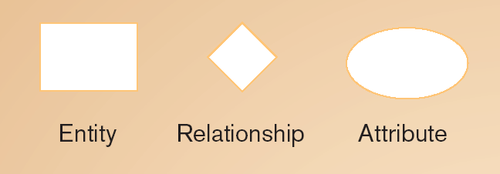

Association between the instances of one or more entity types
EntityName
Verb Phrase
AttributeName
Person, place, object, event or concept about which data is to be maintained
named property or characteristic of an entity
Represents a set or collection of objects in the real world that share the same properties

Slide 30
E-R modeling technique is a :
A. Top-down approach B. Bottom-up approach C. Left-right approach D. None of the above

Slide 31
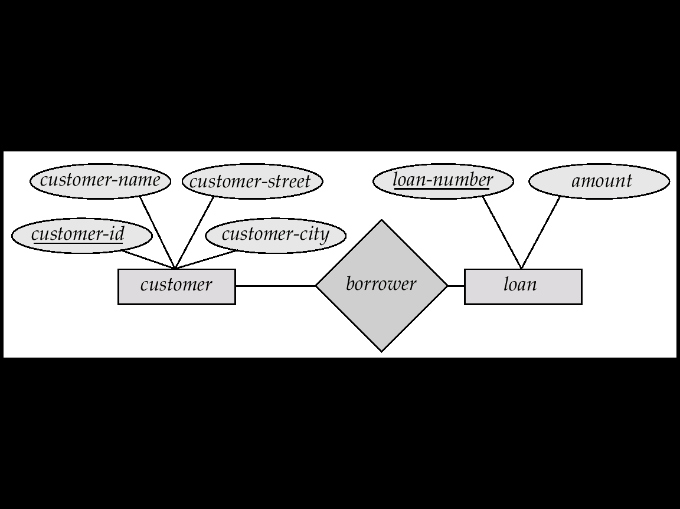
An Example

Slide 32
Entities
Examples of entities:
Person: EMPLOYEE, STUDENT, PATIENT
Place: STORE, WAREHOUSE
Object: MACHINE, PRODUCT, CAR
Event: SALE,REGISTRATION, RENEWAL
Concept: ACCOUNT, COURSE
Guidelines for naming and defining entity types:
An entity type name is a singular noun
An entity type should be descriptive and specific
An entity name should be concise
Event entity types should be named for the result of the event, not the activity or process of the event.

Slide 33
Attributes
Example of entity types and associated attributes:
STUDENT: Student_ID, Student_Name, Home_Address, Phone_Number, Major
Guidelines for naming attributes:
An attribute name is a noun.
An attribute name should be unique
To make an attribute name unique and clear, each attribute name should follow a standard format
Similar attributes of different entity types should use similar but distinguishing names.
Attribute Types:
Simple and composite attributes
Single-valued and multi-valued attributes
Derived attribute

Slide 34
Entity Types
Regular Entity : Entity that has its own key attribute (s). Aka Strong entity
E.g.: Employee, student ,customer, policy holder etc.
Weak entity: Entity that depends on other entity for its existence and doesn’t have key attribute (s) of its own
E.g. : spouse of employee
Notes:
The spouse data is identified with the help of the employee id to which it is related

Slide 35
Which of the following used to denote entity?
A
B
C
D

Slide 36
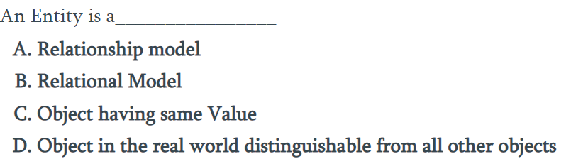

Slide 37
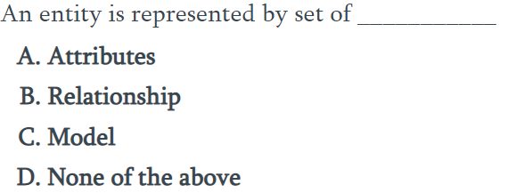

Slide 38
Entity can be which of the following:
Person
Place
Object
All of the above

Slide 39
Attributes
The set of possible values for an attribute is called the domain of the attribute
Example:
The domain of attribute marital status is having four values: single, married, divorced or widowed.
The domain of the attribute month is having twelve values ranging from January to December.
Key attribute: The attribute (or combination of attributes) that is unique for every entity instance
E.g.: the account number of an account, the employee id of an employee etc.
Notes:
Key attribute mentioned in the slide should not be miss understood with key attribute discussion of relational model. The key attribute discussion here is only in the context of ER Diagram.

Slide 40

Attribute Type
Types of Attributes | Definition | Example
Simple attribute | Cannot be divided into simpler components | Gender of the employee
Composite attribute | Can be split into components | Date of joining of the employee
Single valued | Can take on only a single value for each entity instance | Age of the employee
Multi-valued | Can take up many values | Skill set of the employee
Stored Attribute | Attribute that need to be stored permanently | Date of joining of the employee
Derived Attribute | Attribute that can be calculated based on other attributes. | Years of service of the employee

Slide 41
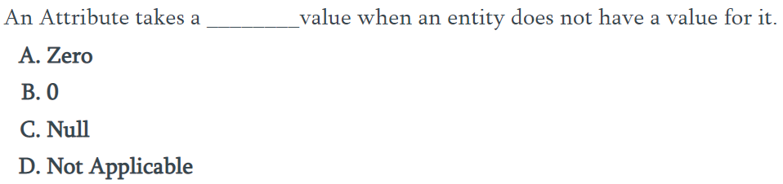

Slide 42
Degree of a Relationship
Degree: the number of entity types involved
One Unary
Two Binary
Three Ternary
E.g.: employee manager-of employee is unary
employee works-for department is binary
customer purchase item, shop keeper is a ternary relationship

Slide 43
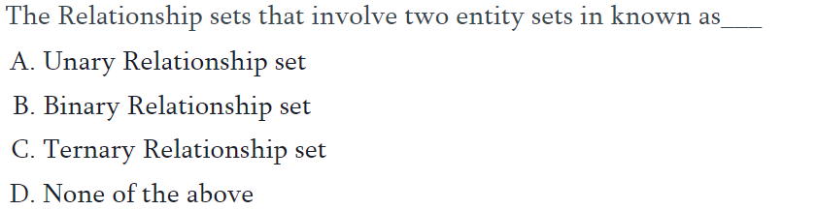

Slide 44
Cardinality
Relationships can have different connectivity
one-to-one (1:1)
one-to-many (1:N)
many-to- One (M:1)
many-to-many (M:N)
E.g.:
Employee head-of department (1:1)
Lecturer offers course (1:N) assuming a course is taught by a single lecturer
Student enrolls course (M:N)
The minimum and maximum values of this connectivity is called the cardinality of the relationship
Notes:
The minimum and maximum values of this connectivity is called the cardinality of the relationship

Slide 45
Relationship Participation
Total : Every entity instance must be connected through the relationship to another instance of the other participating entity types
Partial: All instances need not participate
E.g.: Employee Head-of Department
Employee: partial
Department: total
All employees will not be head-of some department. So only few instances of employee entity participate in the above relationship. But each department will be headed by some employee.
So department entity’s participation is total and employee entity’s participation is partial in the above relationship.
Notes:
All employees will not be head-of some department. So only few instances of employee entity participate in the above relationship. But each department will be headed by some employee.
So department entity’s participation is total and employee entity’s participation is partial in the above relationship.

Slide 46
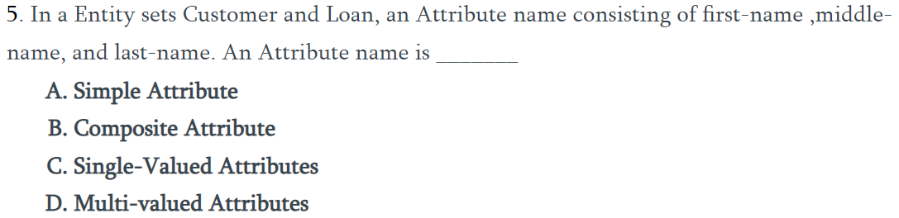

Slide 47

ER Modeling - Notations

Slide 48
ER Modeling -Notations
 | An Entity is an object or concept about which business user wants to store information.
 | A weak Entity is dependent on another Entity to exist. Example Order Item depends upon Order Number for its existence. Without Order Number it is impossible to identify Order Item uniquely.
 | Attributes are the properties or characteristics of an Entity
 | A key attribute is the unique, distinguishing characteristic of the Entity
 | A multi-valued attribute can have more than one value. For example, an employee Entity can have multiple skill values.

Slide 49
ER Modeling -Notations
 | A derived attribute is based on another attribute. For example, an employee's monthly salary is based on the employee's basic salary and House rent allowance.
 | Relationships illustrate how two entities share information in the database structure.
 | To connect a weak Entity with others, you should use a weak relationship notation.

Slide 50
ER Modeling -Notations
Customer
 | Cardinality specifies how many instances of an Entity relate to one instance of another Entity. M,N both represent ‘MANY’ and 1 represents ‘ONE’ Cardinality
1
N
1
M
Account
Transaction
 | In some cases, entities can be self-linked. For example, employees can supervise other employees

Slide 51
Composite attribute
floor
building
DOB
Name
Address
E#
Designation
Employee
Represented by an ellipse from which other ellipses emanate and represent the component attributes. E.g Address
Notes:
Represented by an ellipse from which other ellipses emanate and represent the component attributes. E.g Address

Slide 52
Unary Relationship
Manages
Employee
A unary relationship is represented as a diamond which connects one entity to itself as a loop.
The relationship above means, some instances of employee manage other instances of Employee.
Notes:
A unary relationship is represented as a diamond which connects one entity to itself as a loop.
The relationship above means, some instances of employee manage other instances of Employee.

Slide 53
Role names
Role names may be added to make the meaning more explicit
subordinate
Manages
Employee
Manager

Slide 54
Binary Relationship
Employee
Works
for
Department
Notes:
A relationship between two entity types

Slide 55
Ternary Relationship
Medicine
Doctor
Prescription
Patient
Notes:
A relationship connecting three entity types.

Slide 56
Relationship participation
1
head
of
1
Employee
department
Total
partial
Notes:
All instances of the entity type Employee don’t participate in the relationship, Head-of.
Every employee doesn’t head a department. So, employee entity type is said to partially participate in the relationship.
But, every department would be headed by some employee.
So, all instances of the entity type Department participate in this relationship. So, we say that it is total participation from the department side.

Slide 57
since
since
name
name
dname
dname
ssn
did
did
budget
lot
budget
Employees
1
1
Departments
Manages
M
Works_In
1
since

Slide 58
Attributes of a Relationship
Medicine
Number of days
dosage
Doctor
Prescription
Patient
These attributes best describe the relationship prescription rather than any individual entity Doctor, Patient or Medicine.
Notes:
These attributes best describe the relationship prescription rather than any individual entity Doctor, Patient or Medicine.

Slide 59
Weak entity
E#
Id
----
name
1
has
N
dependant
Employee
The dependant entity is represented by a double lined rectangle and the identifying relationship by a double lined diamond
Notes:
The identifying relationship is the one which relates the weak entity (dependent) with the strong entity (Employee) on which it depends.
Id is underlined with a dotted line because it is used to form composite key of dependent entity along with E#.

Slide 60
Case Study – ER Model For a college DB
Assumptions :
A college contains many departments
Each department can offer any number of courses
Many instructors can work in a department
An instructor can work only in one department
For each department there is a Head
An instructor can be head of only one department
Each instructor can take any number of courses
A course can be taken by only one instructor
A student can enroll for any number of courses
Each course can have any number of students

Slide 61
Steps in ER Modeling
Identify the Entities
Find relationships
Identify the key attributes for every Entity
Identify other relevant attributes
Draw complete E-R diagram with all attributes including Primary Key
Review your results with your Business users
Visit the following link for more information
10 Easy Steps to Create an ER Diagram in VISIO 2000

Slide 62
Steps in ER Modeling
Step 1: Identify the Entities
DEPARTMENT
STUDENT
COURSE
INSTRUCTOR

Slide 63
Steps in ER Modeling
Step 2: Find the relationships
One course is enrolled by multiple students and one student enrolls for multiple courses, hence the cardinality between course and student is Many to Many.
The department offers many courses and each course belongs to only one department, hence the cardinality between department and course is One to Many.
One department has multiple instructors and one instructor belongs to one and only one department , hence the cardinality between department and instructor is one to Many.
Each department there is a “Head of department” and one instructor is “Head of department “,hence the cardinality is one to one .
One course is taught by only one instructor, but the instructor teaches many courses, hence the cardinality between course and instructor is many to one.

Slide 64
Steps in ER Modeling
Step 3: Identify the key attributes
Deptname is the key attribute for the Entity “Department”, as it identifies the
Department uniquely.
Course# (CourseId) is the key attribute for “Course” Entity.
Student# (Student Number) is the key attribute for “Student” Entity.
Instructor Name is the key attribute for “Instructor” Entity.
Step 4: Identify other relevant attributes
For the department entity, the relevant attribute is location
For course entity, course name,duration,prerequisite
For instructor entity, room#, telephone#
For student entity, student name, date of birth

Slide 65
Entities
DEPARTMENT NAME
LOCATION
DEPARTMENT
STUDENT
STUDENT#
STUDENT NAME
DATE OF BIRTH

Slide 66
COURSE
PRE REQUISITE
COURSE#
COURSE NAME
DURATION
INSTRUCTOR
INSTRUCTOR NAME
TELEPHONE#
ROOM#

Slide 67
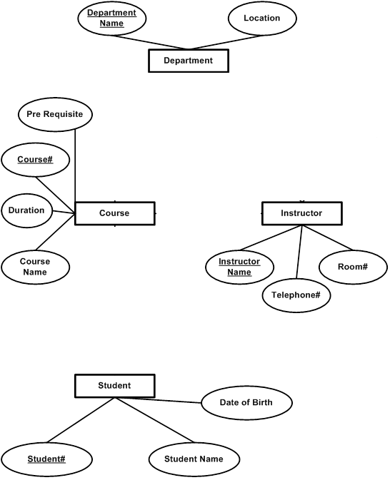

Slide 68
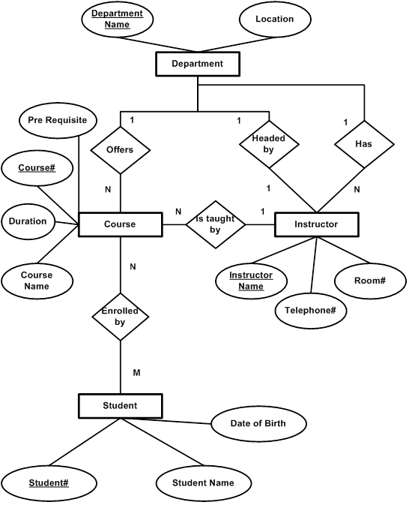

Slide 70
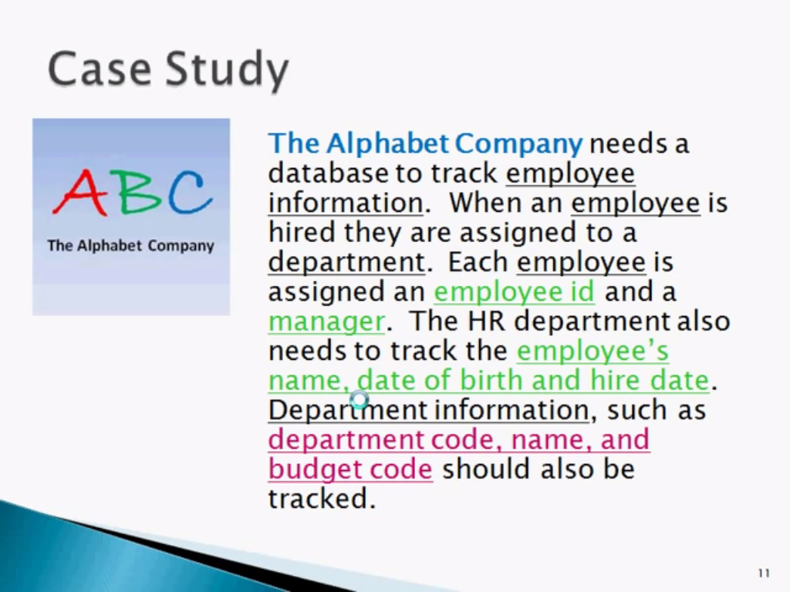

Slide 71
Specialization
A lower-level entity set inherits all the attributes and relationship participation of the higher-level entity set to which it is linked.
A lower-level entity set may have additional attributes and participate in additional relationships

Slide 72
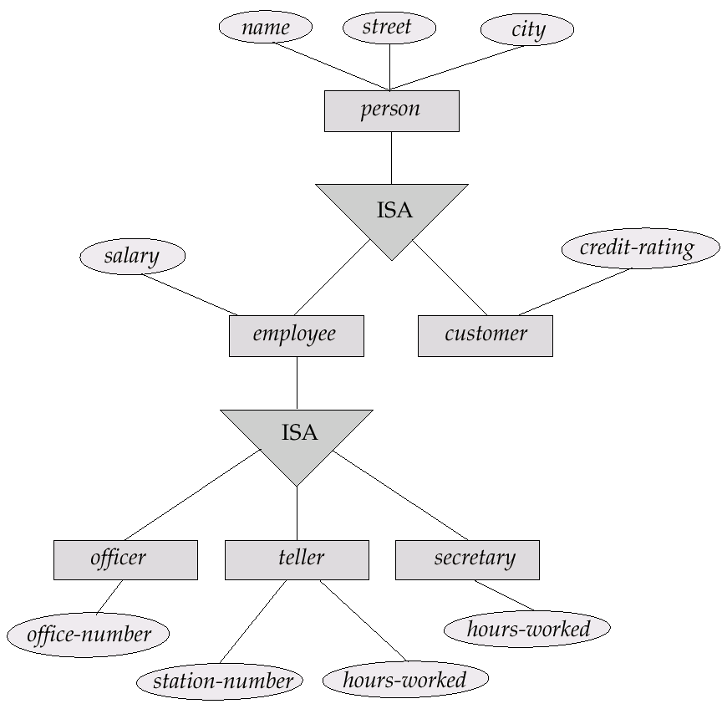

Slide 73
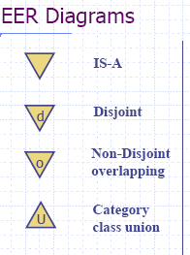

Specification
Disjoint/Overlapping
Completeness constraint
(use double lines)
total : an entity must belong to one of the lower-level entity sets
partial: an entity need not belong to one of the lower-level entity sets

Slide 74
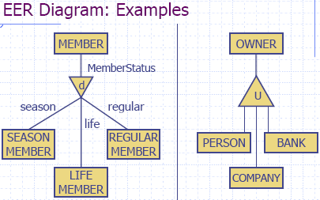
Category owner is the subclass of the set union of entity types person, company and bank

Slide 75
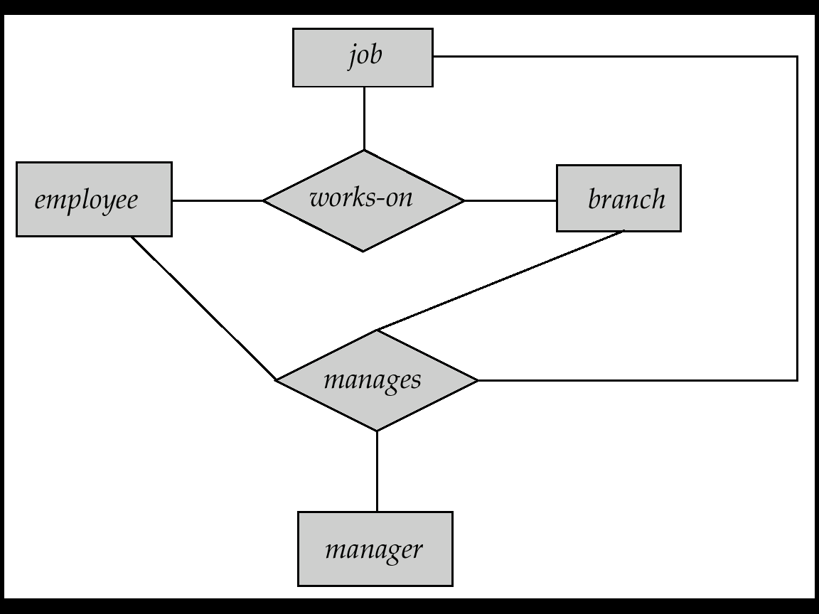
Aggregation
Consider the ternary relationship works-on, which we saw earlier
Suppose we want to record managers for tasks performed by an employee at a branch

Slide 76
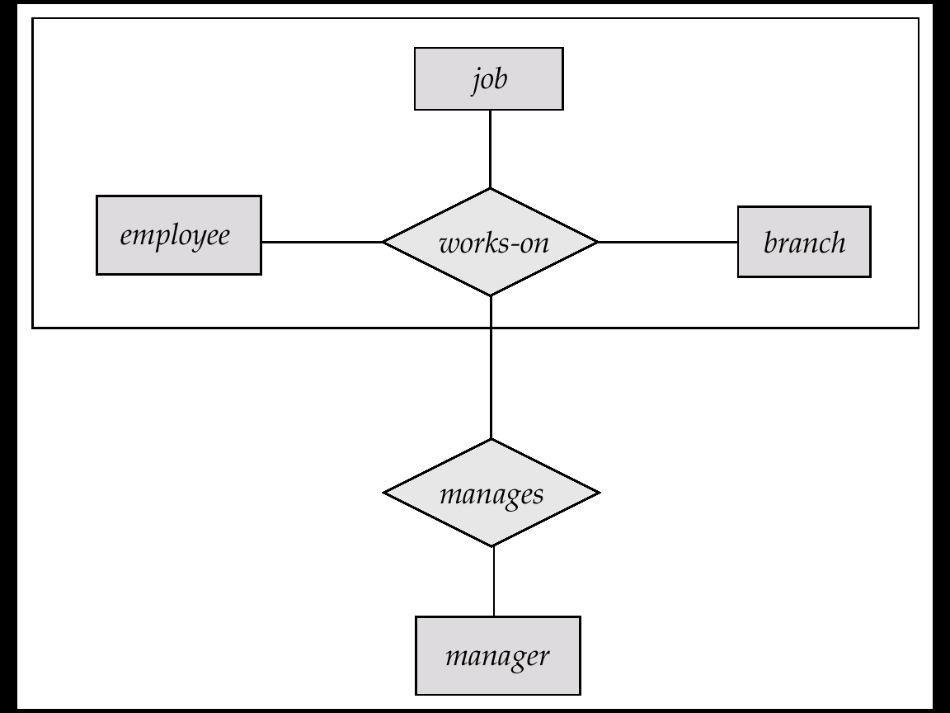
E-R Diagram With Aggregation

Slide 77
Design Considerations
Use of entity sets vs. attributes
Whether we want to keep additional information
Use of entity sets vs. relationship sets
Actions among entities are usually represented by relationships
Binary versus n-ary relationship sets
N-nary relationships are usually more natural for actions among entity sets
Weak entity set vs. strong entity set
Generalization

Slide 78
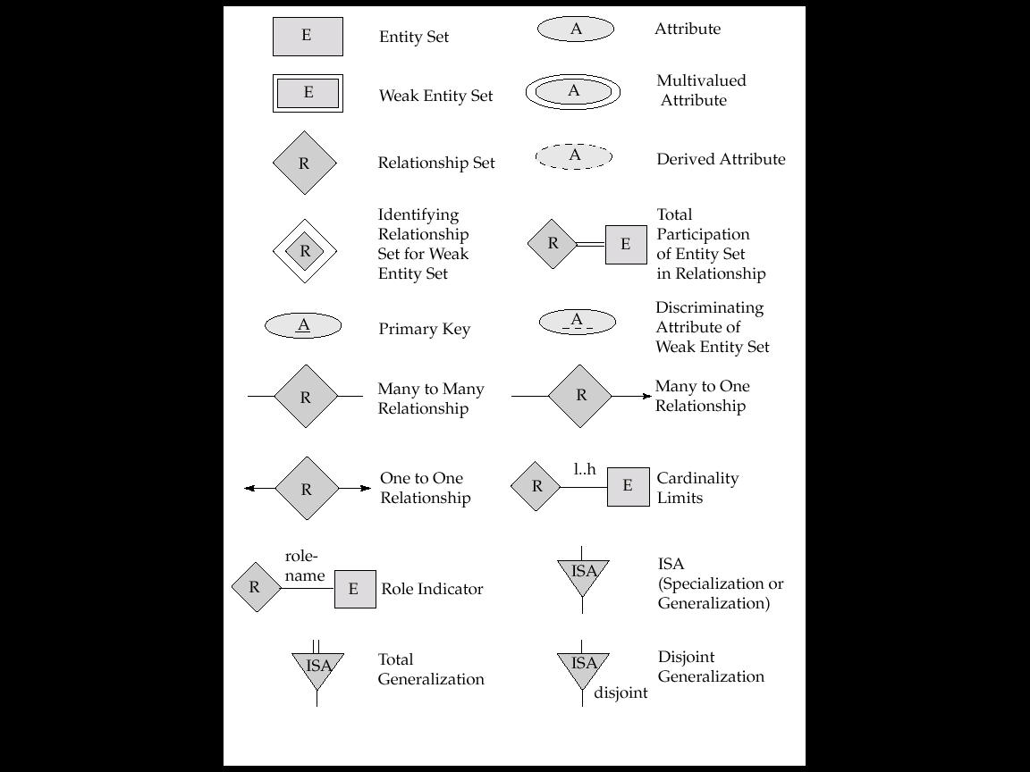
Notations

Slide 79

Notations

Slide 80
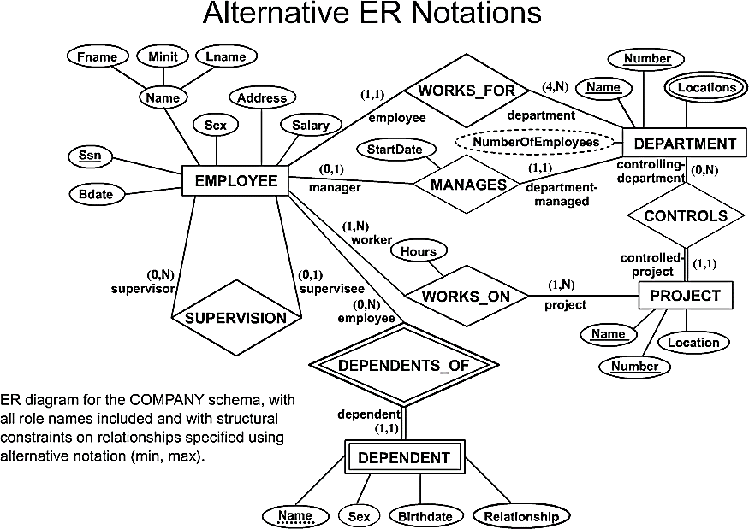
COMPANY ER Schema Diagram using (min, max) notation

Slide 81
Designing an ER Diagram
Consider the following set of requirements for a University database. Design an ER diagram for this application:
The university keeps track of each student's name, student number, social security number, current address and phone number, permanent address and phone number, birthdate, sex, class (freshman, graduate), major department, minor department (if any), degree program (B.A., B.S., ... Ph.D.). Some user applications need to refer to the city, state, and zip code of the student's permanent address and to the student's last name. Both social security number and student number are unique for each student. All students will have at least a major department.
Each department is described by a name, department code, office number, office phone, and college. Both the name and code have unique values for each department.
Each course has a course name, description, course number, number of credits, level and offering department. The course number is unique for each course.
Each section has an instructor, semester, year, course, and section number. The section number distinguishes sections of the same course that are taught during the same semester/year; its value is an integer (1, 2, 3, ... up to the number of sections taught during each semester).
A grade report must be generated for each student that lists the section, letter grade, and numeric grade (0,1,2,3, or 4) for each student and calculates his or her average GPA.

Slide 82
University ER Diagram
Degree
Major In
DName
DCode
OfficeNumber
Name
StudentID
SSN
Birth date
Department
OfficePhone
Sex
Student
Minor In
College
Class
Address
Offer
City
State
Zip
Grade_Report
CName
CourseDesc
Letter Grade
Instructor
Year
Course
GPA
CNumber
Belong_To
Credits
Numeric Grade
Section
SectionNumber
Semester

Slide 83
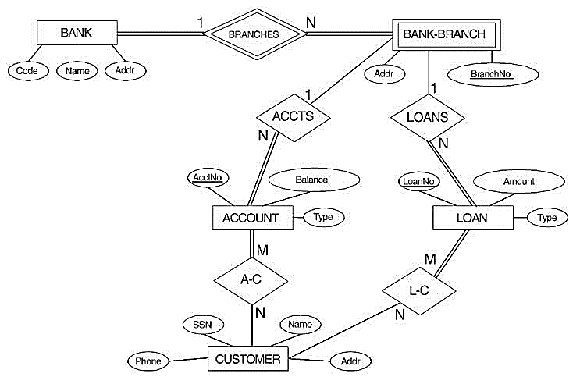
ER DIAGRAM FOR A BANK DATABASE

Slide 84
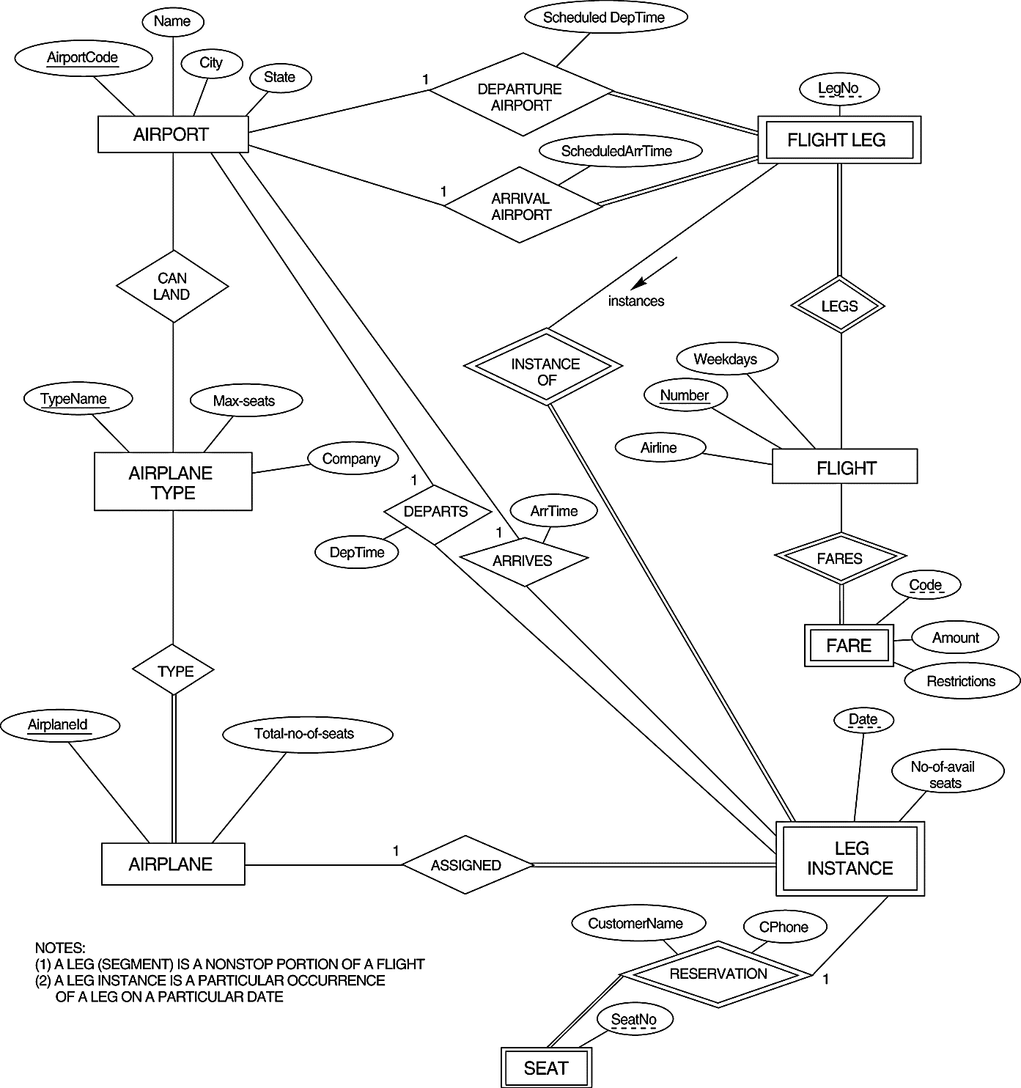
An ER diagram for an AIRLINE database schema.

Slide 85
Enhanced ER Model

Slide 86
Superclass/Subclass
Subclasses
Subgroupings of the entities of an entity type
An entity type as a superclass of subclasses
Examples
EMPLOYEE {SALARIED_EMPLOYEE, HOURLY_EMPLOYEE}
PATIENT {OUTPATIENT, INPATIENT}
STUDENT {FULL-TIME, PART-TIME}

Slide 87
Superclass/Subclass
“IS-A” relationship
Members of a subclass must be members of the superclass
A FULL-TIME STUDENT ISA STUDENT
Not every entity in a superclass be a member of a subclass
Subclasses
Should have meaningful subgroupings
Should be related to database applications

Slide 88
Entity Type Inheritance
Type Inheritance among Classes
Inherited Attributes
a subclass inherits the attributes of the superclass
HOURLY_EMPLOYEE (Name, SSN, Address)
Local (Specific) Attributes
a subclass may have its own attributes
HOURLY_EMPLOYEE (Hourly_rate)
SALARIED_EMPLOYEE (Annual_salary)

Slide 89
EER Example
Entity Type Inheritance

Slide 90
Specialization & Generalization
superclass-subclass relationship
Specialization: a means of identifying sub-groups within an entity set which have attributes which are not shared by all the entities (top-down)
Generalization: Multiple entity sets are synthesized into a higher level entity set based on common features (bottom-up)
E-R Symbol:
ISA

Slide 91
Specialization

Slide 92
Generalization

Slide 93
Inheritance
A lower-level entity set inherits all the attributes of the higher level entity sets
A subclass (lower level entity) also inherits participation in the relationship sets in which its superclass (higher-level entity) participates.
The outcome of specialization and generalization is the same: hierarchy of entity sets.

